Slide 1

How to train your network data
Matthew Nunes

Slide 2
Who am I
Studied at Cardiff University
Worked at Cardiff University
Currently working in PwC’s Ethical Hacking team

Slide 3
Overview
NetworkMiner
Zeek
Network Flows
Network data – things to remember / Machine Learning

Slide 4
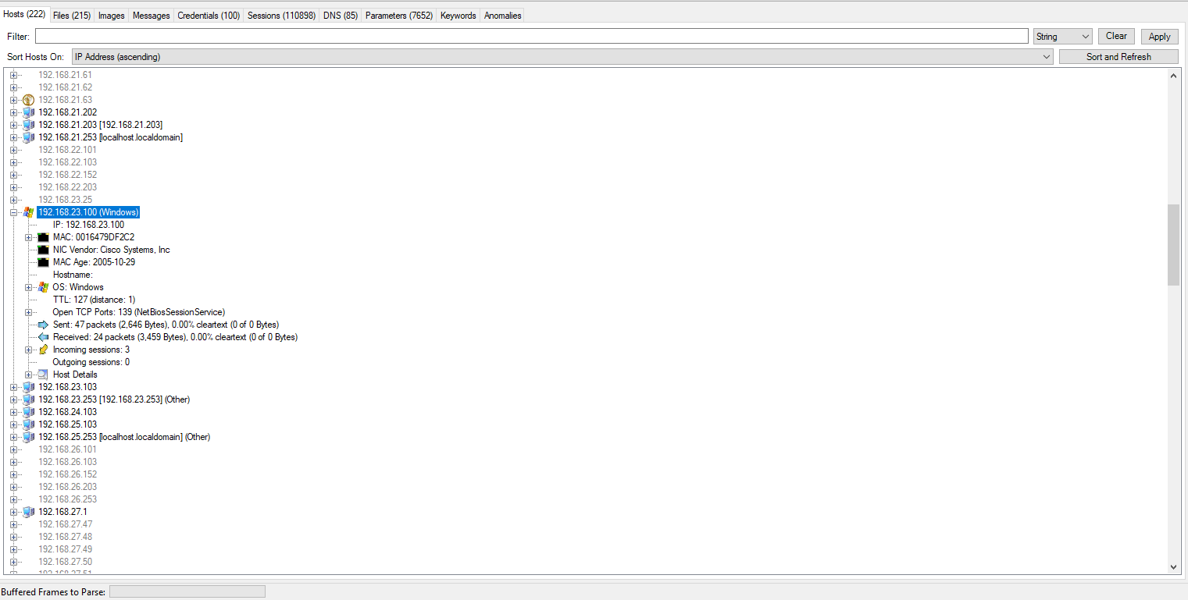
Network Miner

Slide 5


Network Miner
Processing files larger than 100Mb takes forever
Only good for getting an overview

Slide 6
Zeek
Processes pcaps in the command-line
zeek -C -r sample.pcap
r: read pcaps
C: Ignore checksum errors
Produces multiple log files in the same folder as the pcap
Always lookout for weird.log

Slide 7
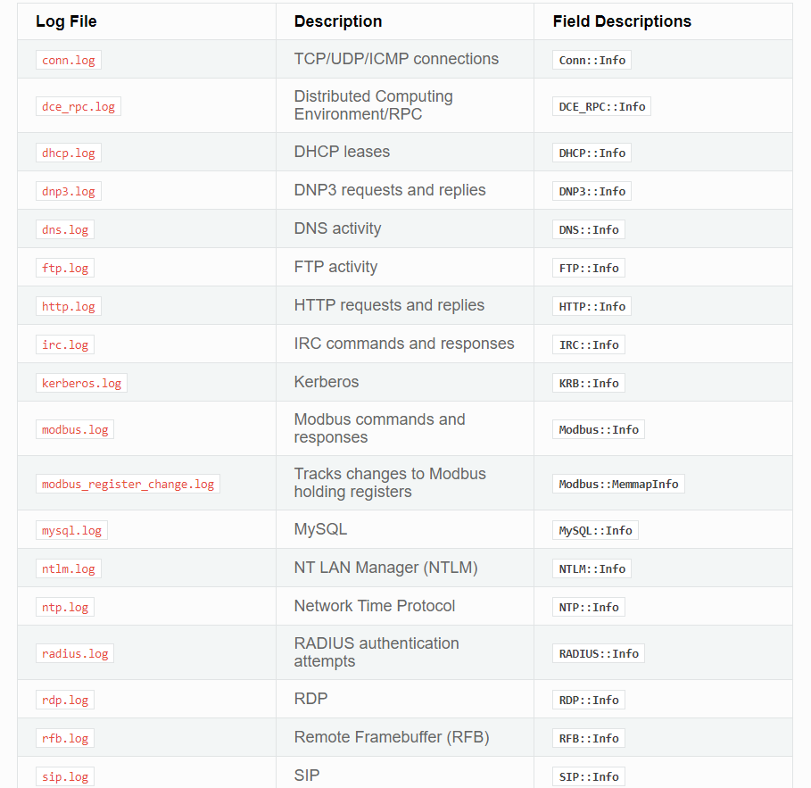
Zeek Logs

Slide 8
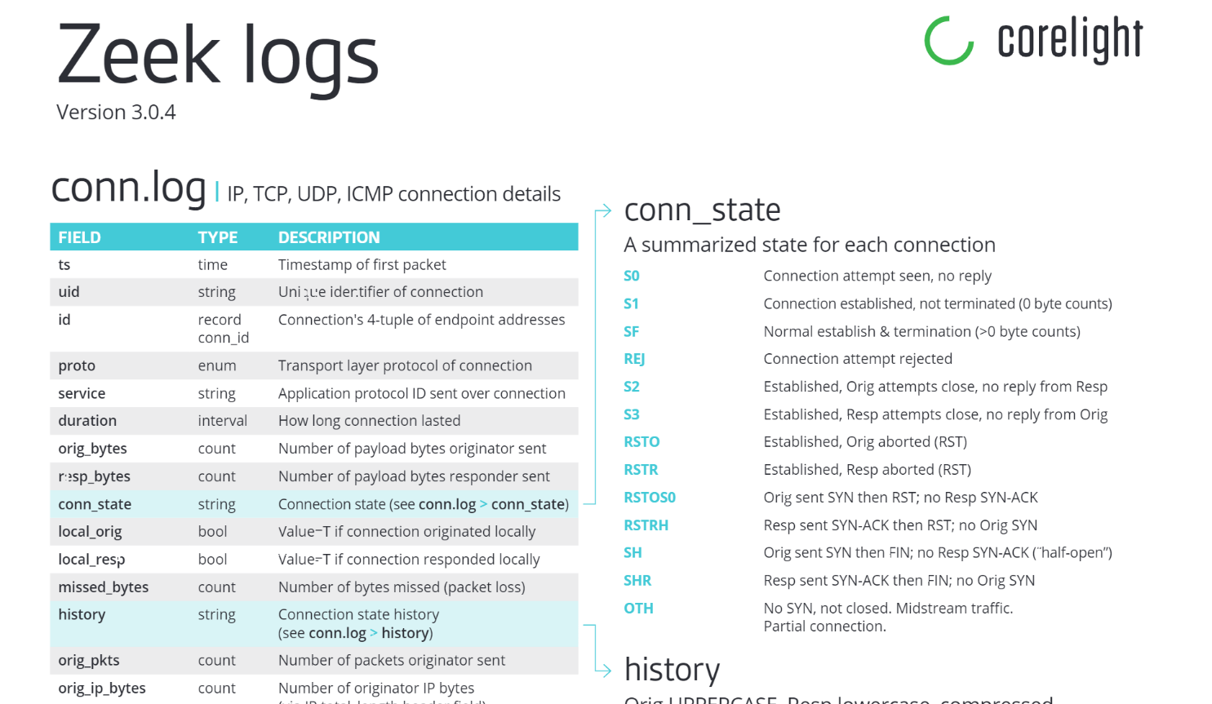
https://github.com/corelight/zeek-cheatsheets/blob/master/Corelight-Zeek-Cheatsheets-3.0.4.pdf

Slide 9
Network Flows / NetFlow
Cisco’s idea
Strips pcaps of payload data
Groups packets that share certain attributes
Src, Dest IP address & Src, Dest Port
80 GB pcap data becomes 300 Mb of flow data
Commonly used to monitor network data
NetFlow is a call log

Slide 10
Pcap: IP
Bit offset | 0-3 | 4-7 | 8-13 |  | 14-15 | 16-18 | 19-31
0 | Version | Internet Header Length | Differentiated Services Code Point |  | Explicit Congestion Notification | Total Length
32 | Identification |  |  |  |  | Flags | Fragment Offset
64 | Time to Live |  |  | Protocol |  | Header Checksum
96 | Source IP Address
128 | Destination IP address
160 | Options
160 or 192+ | Data

Slide 11
Pcap: TCP
Octet | 0 |  |  |  |  |  |  |  | 1 |  |  |  |  |  |  |  | 2 |  |  |  |  |  |  |  | 3
Bit | 0 | 1 | 2 | 3 | 4 | 5 | 6 | 7 | 8 | 9 | 10 | 11 | 12 | 13 | 14 | 15 | 16 | 17 | 18 | 19 | 20 | 21 | 22 | 23 | 24 | 25 | 26 | 27 | 28 | 29 | 30 | 31
0 | Source port |  |  |  |  |  |  |  |  |  |  |  |  |  |  |  | Destination port
32 | Sequence number
64 | Acknowledgment number (if ACK is set)
96 | Data offset |  |  |  | Reserved |  |  | NS | CWR | ECE | URG | ACK | PSH | RST | SYN | FIN | Window size
128 | Checksum |  |  |  |  |  |  |  |  |  |  |  |  |  |  |  | Urgent pointer (if URG is set)
160 … | Options

Slide 12
Pcap: UDP
Bit Offset | 0-15 | 16-31
0 | Source port | Destination port
32 | Length | Checksum
64 … | Data

Slide 13

Argus

Slide 14

Argus

Slide 15
Argus
Installing Argus
sudo apt install argus-server
sudo apt install argus-clients
Running Argus
argus -r packet.pcap -w packet.argus (Converts data into intermediary argus format)
ra -r packet.argus -c , > output.csv (Converts data into CSV format. –c option allows you to specify a field separator)

Slide 16
Argus – Useful Options
ra -r packet.argus -c , -s stime saddr daddr proto sport dport pkts bytes > output.csv
-s lets you specify fields to output
-nn: The first -n will suppress port number to service conversion, -nn will suppress translation of protocol numbers to names (no lookups)

Slide 17
Exploring Argus Data
Getting started guide: https://openargus.org/index.php/using-argus
Clients overview: https://openargus.org/argus-stream
Clients more details: https://openargus.org/oldsite/ra.core.examples.shtml
Dirty manuals: https://openargus.org/oldsite/manuals.shtml
Using Argus with Python – an example: https://openargus.org/ra-python

Slide 18
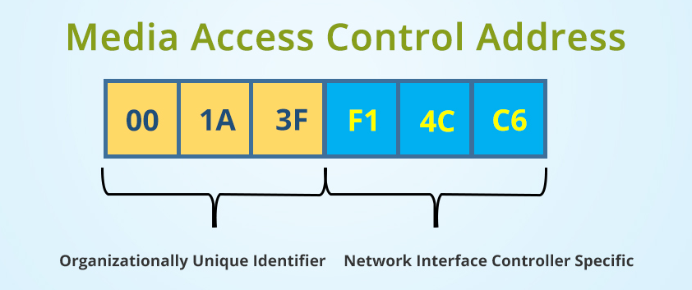
Network Data - Considerations
Mac Address Lookup

Slide 19
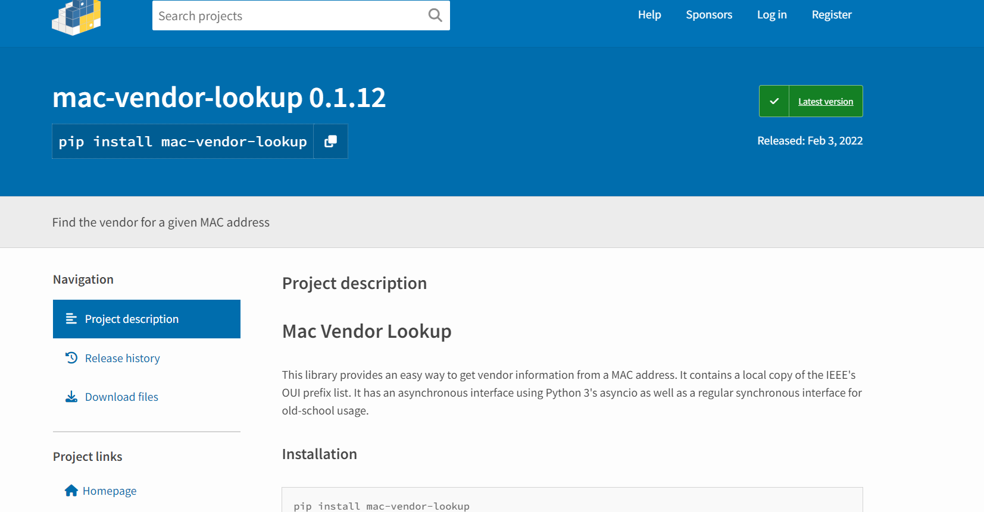
Network Data - Considerations

Slide 20
Network Data - Considerations
Internal vs External IP Addresses
Class A: 10.0.0.0 — 10.255.255.255
Class B: 172.16.0.0 — 172.31.255.255
Class C: 192.168.0.0 — 192.168.255.255
Traffic that isn’t point-to-point
Broadcast (255.255.255.255, 192.168.10.255)
Multicast (224.0.0.0-239.255.255.255)

Slide 21
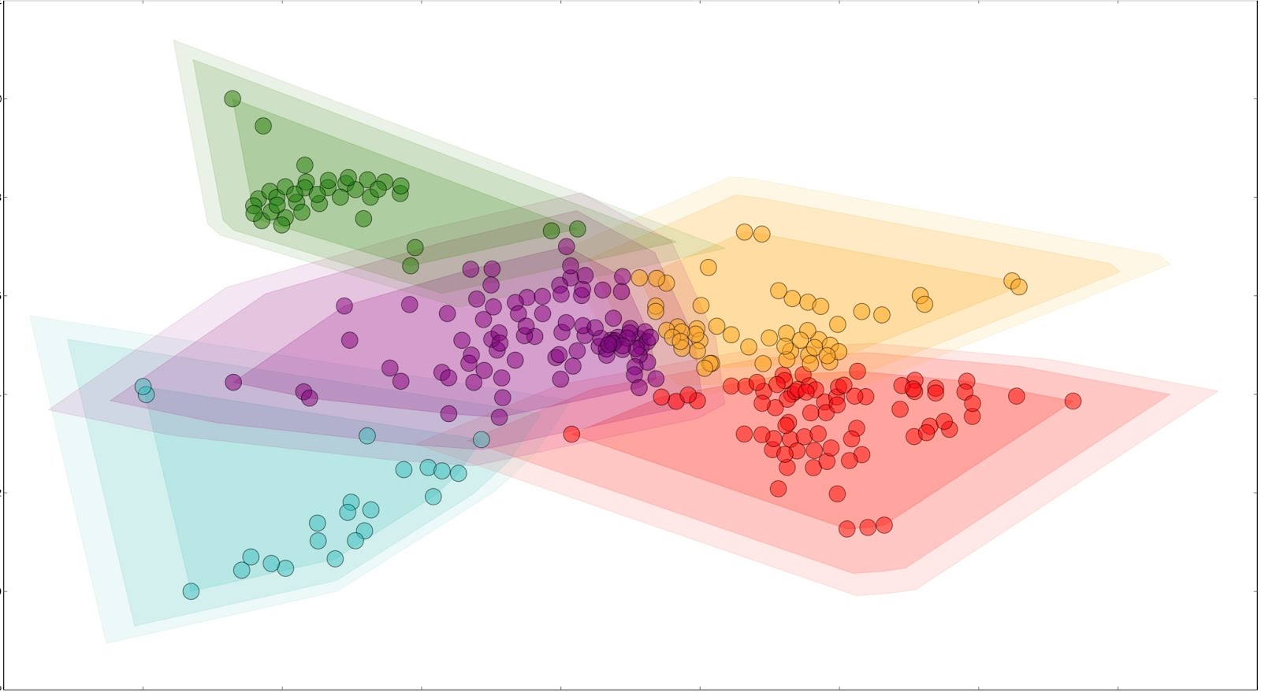
Where to start?
Top 10 Source IPs by packets/bytes
Top 10 Ports
Ratio of sent vs received for each host
Destination IPs contacted per Source IP
Traffic with lots of flows but small number of bytes
Interesting Protocols: DNS, NTP, SMB, SNMP, LDAP
Weird things (high ports, lots of pings etc.)
Domain Controllers
FTP Servers
Web Servers
DNS Servers
Windows Desktops

Slide 22
Where to start - Chaining
Host C
Time: 10:17
Dst Port: 22
Host B
Time: 10:15
Dst Port: 22
Host D
Host A
Host E
Host F

Slide 23
Other Tools
Wireshark/Tshark
Yet Another Flowmeter (YAF)
SiLK/iSiLK

Slide 24
Questions?

